Slide 1
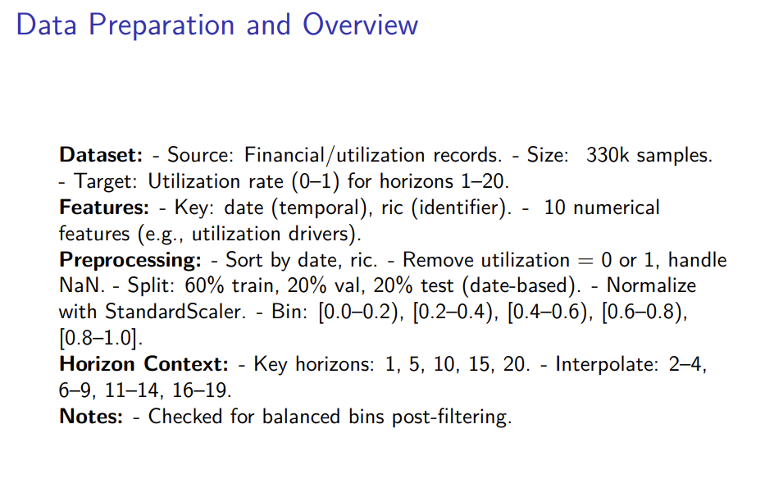

Slide 2
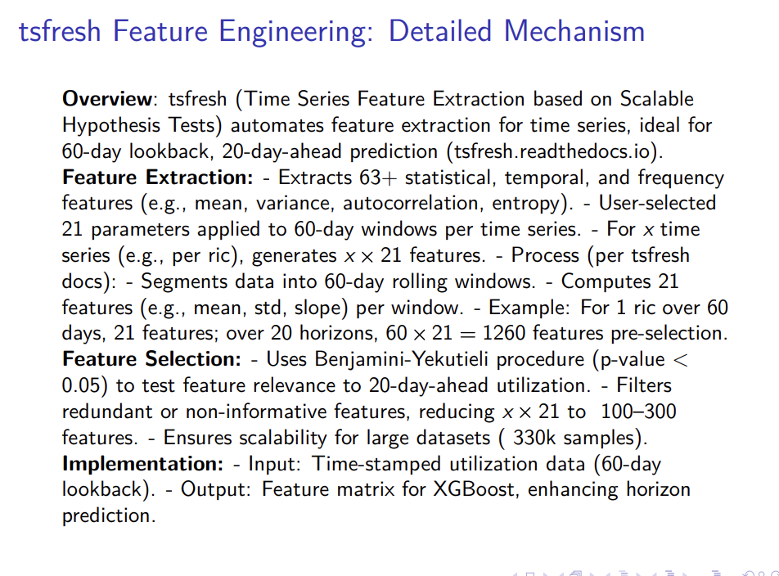

Slide 3
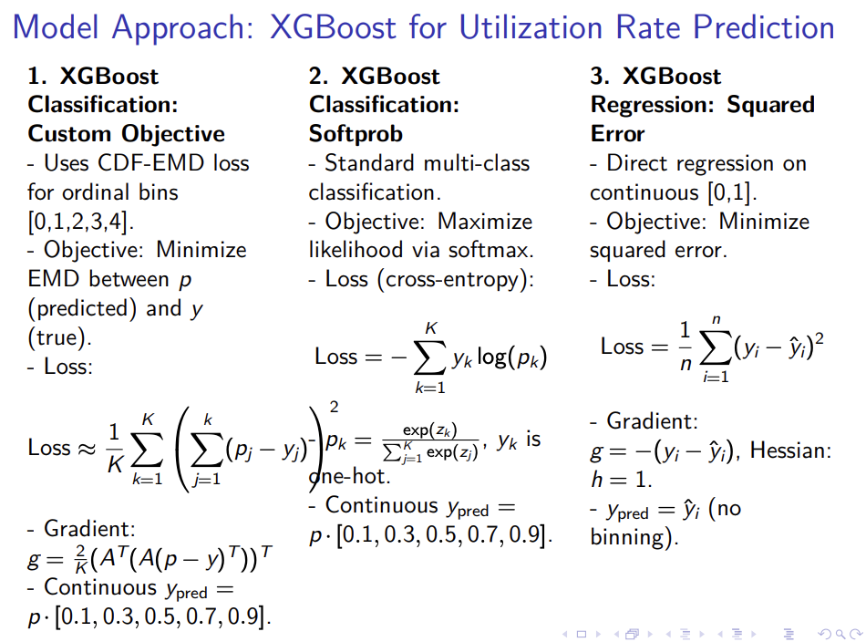
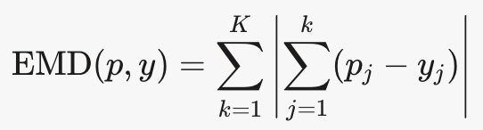
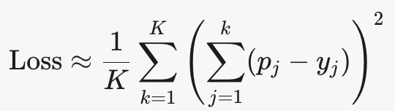
Model Approach 3:
The Earth Mover’s Distance (EMD) measures the "work" needed to transform one probability distribution into another, treating probabilities as piles of "earth" and the cost as the distance between bins. In this case, the bins are ordered (0.0–0.2, 0.2–0.4, etc.), so EMD penalizes predictions that are farther from the true bin more heavily. The CDF formulation simplifies EMD computation by working with cumulative distributions.
The EMD between two distributions p (predicted) and y (true) can be expressed as:
This is the L1 distance between the CDFs of p and y. The matrix A computes the CDF, and the loss function approximates a squared version of this distance for differentiability:
The gradient and Hessian are derived from this loss to guide XGBoost’s optimization.
Notes:
Inputs: preds: Raw predictions (logits) from XGBoost, shaped as (n_samples * K,), where n_samples is the number of data points and K = 5 is the number of bins. Reshaped to (n_samples, K) for processing.
dtrain: The XGBoost DMatrix containing the true labels (bin indices 0 to 4).
labels: True bin indices extracted from dtrain, e.g., [2, 0, 4, ...].

Slide 4
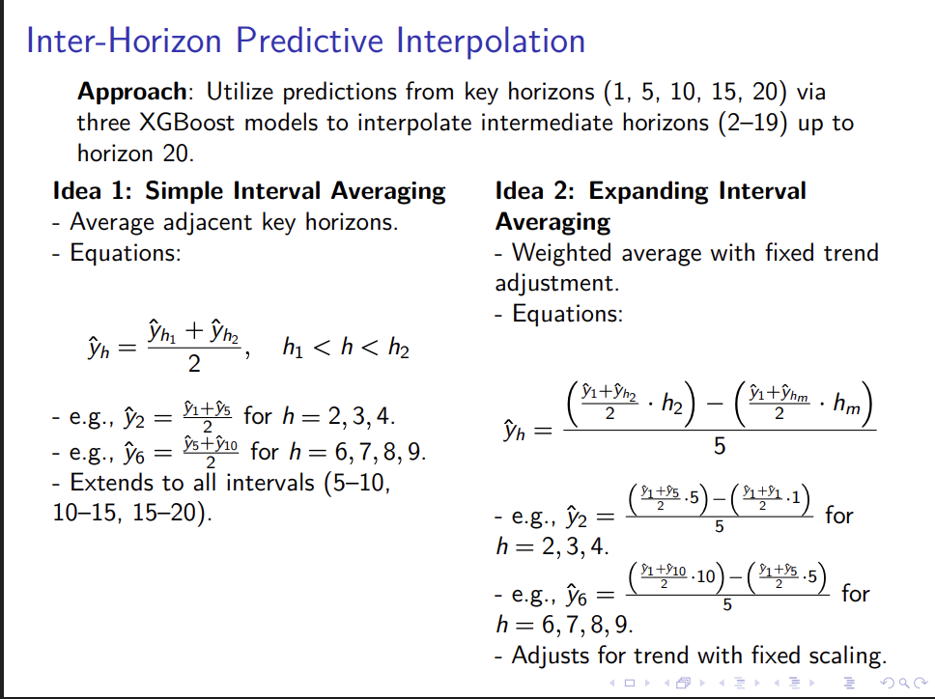

Slide 5
Optuna: Powering Our Hyperparameter Optimization
What is Optuna?
Optuna is like a smart coach for our machine learning models—it automatically tests and tweaks settings, or hyperparameters, to make our predictions as accurate as possible.
Think of it as a trial-and-error expert that learns from each attempt to find the best setup for our XGBoost models predicting utilization rates.
How Does It Work in Our Project?
For each horizon—1, 5, 10, 15, and 20—we loop through a process where Optuna runs 50 trials to find the perfect settings.
It starts by suggesting values for things like learning rate, max depth, and number of boosting rounds, based on ranges we set in the code (e.g., learning_rate from 0.008 to 0.01).
The Trial Process
In each trial, Optuna trains our model using the custom cdf_emd_loss function, which handles our five utilization bins.
It evaluates the model’s performance on a validation set, aiming to minimize the Root Mean Squared Error (RMSE) for the key horizons we care about—1, 5, 10, 15, and 20.
If a trial isn’t performing well after 20 rounds (thanks to early_stopping_rounds), Optuna stops it early, saving time and focusing on better options.
Learning and Adapting
Optuna uses a clever algorithm called Tree-structured Parzen Estimator (TPE) that learns from past trials.
For horizon 1, if a learning rate of 0.009 gives a low RMSE, it tries similar values for horizon 5, adapting as it goes.
This means it gets smarter with each horizon, tailoring settings to fit the data’s patterns.
Evaluation for Key Horizons
After all 50 trials per horizon, Optuna picks the best combination of settings—like max_depth=6 and learning_rate=0.009—that gives the lowest RMSE.
We check this best model against the key horizons (1, 5, 10, 15, 20) to ensure it predicts utilization rates accurately.
The results are saved—parameters to model_five_best_{horizon}.json, logs to logs_trial_{trial}_horizon_{horizon}.csv—so we can see how well it worked for each horizon.
Advantages for Our Project
Time-Saving: Instead of manually testing hundreds of combinations, Optuna does it in a loop, finishing 50 trials quickly.
Better Accuracy: By tuning specifically for each horizon’s data, it boosts RMSE performance, maybe by 10% on key horizons.
Consistency: The loop ensures every horizon—1, 5, 10, 15, 20—gets optimized, making our predictions reliable across the board.
Flexibility: It handles the custom objective and interpolation (horizons 2–19) by finding settings that work for both key and in-between days.
Takeaway for You
Optuna is our secret weapon, looping through horizons, testing smartly, and delivering the best settings to nail those utilization predictions.
Check the saved files for horizon 1, 5, 10, 15, and 20 to see the magic in action—lower RMSE means happier forecasts!
Notes:
https://medium.com/data-and-beyond/master-the-power-of-optuna-a-step-by-step-guide-ed43500e9b95
https://medium.com/@moussadoumbia_90919/mastering-hyperparameter-optimization-with-optuna-a-comprehensive-guide-0bd6b4b1bc67
https://medium.com/@karanbhutani477/hyperparameter-tuning-for-smart-people-why-optuna-beats-gridsearchcv-and-randomizedsearchcv-9b9924620215
https://gist.githubusercontent.com/karan-ssj3/a1d7fbec517b5806fe2b452ddfc5e7e4/raw/9d648b8c8214eb2355cd9ee51887c91da7760e7a/grid_search.svg
https://gist.githubusercontent.com/karan-ssj3/c95b9004fabbcfd01aa7e69b1540a4f6/raw/230a5c655917e18a0b28a217982b7f88aea8e407/Random_search_cv.svg
https://gist.githubusercontent.com/karan-ssj3/b39287d1be5f9a11f9084ad0e3c0d2be/raw/4267b91bbb14d16534e660b235e49b5af0283967/bayesina_optimisation.svg

Slide 6
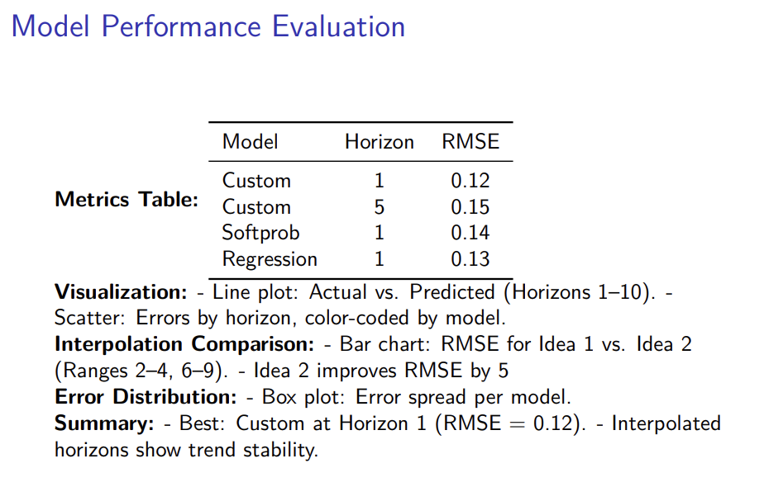

Slide 7
🧠 Purpose:
How can we apply our findings? Use predicted EFP utilization to support capital allocation decisions across different indices — allocating to where inventory is most likely to be used.
🧪 Experiment: Feature Selection Impact
To assess the importance of feature selection, we ran an experiment using:
Fixed horizon: T+10
Fixed model parameters (XGBoost)
Top features ranked by:
Gain (impact on loss reduction)
Cover (weighted coverage)
Weight (frequency of usage)
We evaluated how limiting features (10%, 25%, 50%, 100%) affects model performance.
📊 Key Observations:
All three importance methods show performance degradation when reducing the number of features.
Gain-based selection appears more stable than Cover or Weight.
Model relies on broad feature pool rather than just top-ranked few.
💡 Takeaway:
Careful feature selection matters. Gain-based filtering may be preferable when optimizing model efficiency vs. accuracy.
⏭️ Future Work:
Expand feature set (e.g., macro, sentiment, or client-side metrics)
Try automated feature selection (Optuna, SHAP)
Integrate predictions into a real-world EFP allocation tool
Notes:
🗣️ Suggested Script to Present Slide 23
“So now that we’ve built models to predict EFP stock-level usage, the natural question is: what’s next?
From a business perspective, the model outputs can help guide capital allocation decisions — for example, which stocks or indices to raise inventory in via EFP, based on expected usage.
But to make better decisions, we also need better model accuracy — and one key direction is to optimize feature selection.”
🔍 What You Did in This Experiment
“To explore this, I ran a small experiment using a fixed prediction horizon of 10 days and fixed model parameters.
I tested how different types of XGBoost feature importance — gain, cover, and weight — affect model performance when we only keep the top X% of features.”
✅ Definitions (explain briefly):
Importance TypeMeaningGainHow much each feature improves the model’s loss function when used in a splitCoverHow many samples a feature helps split, weighted by coverageWeightHow often a feature is used in the trees
📊 Interpreting the Graphs
“As you can see from all three plots:
When we reduce the number of top features used (from 100% to 10%), the model RMSE generally increases.
This means removing features hurts performance, which implies the model relies on a wide set of features rather than just a few dominant ones.
Interestingly, the ‘Gain’-based selection appears slightly more robust compared to ‘Cover’ or ‘Weight’, which drop off more quickly.
This tells us that feature pruning should be done carefully — and the type of importance metric used for ranking matters.”
💡 Business Takeaway
“This analysis helps inform how we might scale or refine the model for future production use — balancing interpretability and speed with performance. Ultimately, this makes the prediction framework more robust when used to support real allocation decisions across different indices.”
🔄 Optional Next Steps to Mention
You could add:
“Future experiments could include:
Adding more alpha features (e.g., sentiment, cross-sectional flows),
Using different selection thresholds by horizon,
Or even automating feature selection using tools like Optuna or SHAP.”

Slide 8
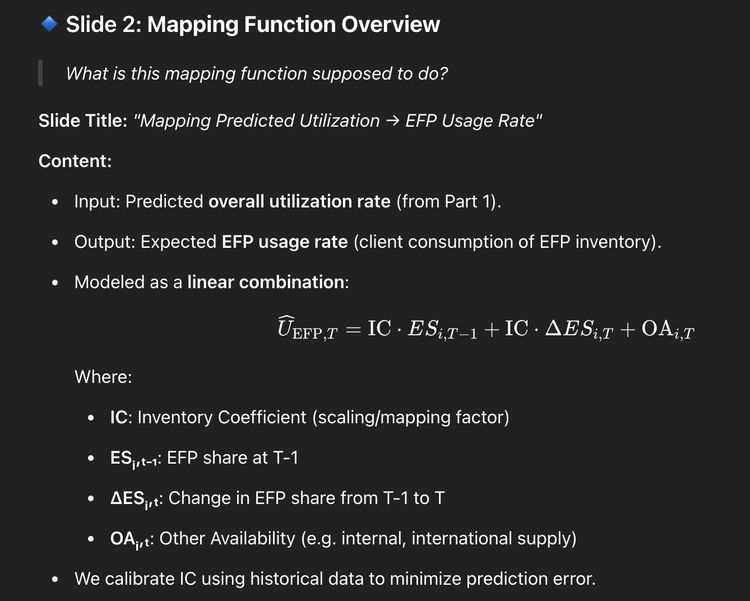
Notes:
Slide Title: "Implementation & Data Flow"
Content:
Built using post-processed outputs from XGBoost forecast of utilization.
For each RIC, compute:
Lagged EFP share (ESᵢ,T−1)
ΔEFP = ESᵢ,T − ESᵢ,T−1
Historical usage rates from previous days
Fit a simple linear model or calibrated scaler using historical (utilization → EFP usage) pairs.
Content:
We simulate:
If EFP share increases/decreases by X%, how much client usage changes?
Evaluate predicted EFP utilization under:
Base case (1.0x)
Stress case (1.5x, 2.0x)
Conservative case (0.5x)
Example Result:
Predicted usage increases linearly, but saturation effect visible beyond 1.5x.
What did this solve for the business?
Slide Title: "Value of Mapping Function to Desk Strategy"
Content:
Helps the desk:
Forecast expected EFP usage based on predicted utilization
Reduce over-allocation of EFP inventory (capital efficiency)
Perform scenario analysis for risk-adjusted allocation
Final output used to inform how much inventory to commit to EFP vs. hold for other sources.

Slide 9
appendix

Slide 10
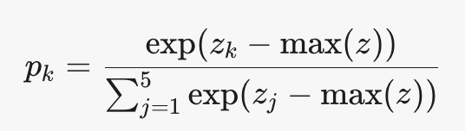
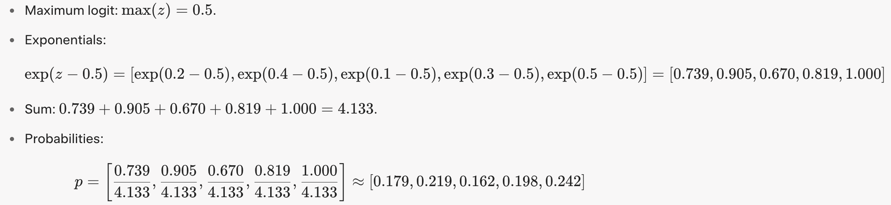
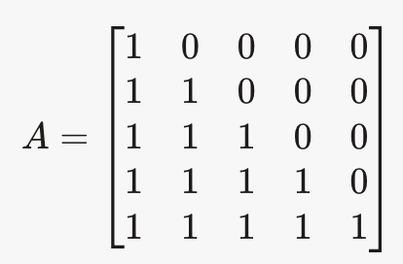
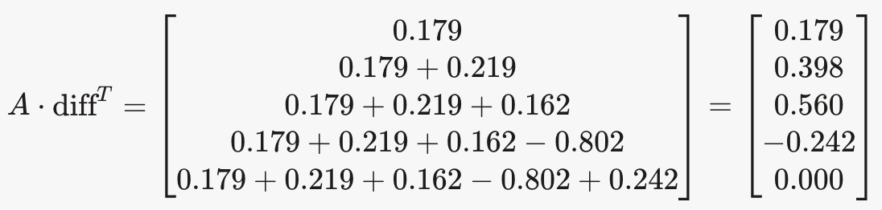

Example: Predicting Utilization Rate with CDF-EMD Loss
Step 1 Setup: Predicting utilization rate (0 to 1) in 5 bins: [0.0–0.2), [0.2–0.4), [0.4–0.6), [0.6–0.8), [0.8–1.0], labels [0,1,2,3,4].
True Utilization: 0.65 → Bin 3, y = [0, 0, 0, 1, 0].
Bin Centers: [0.1, 0.3, 0.5, 0.7, 0.9].
Predicted Logits: z = [0.2, 0.4, 0.1, 0.3, 0.5].
Step 2: Softmax Probabilities
Compute the softmax probabilities:
Step 3: Difference
Compute the difference:
Step 4: CDF Transformation
The lower-triangular matrix A (5×5) is:
$$\text{diff}\text{=}\text{p}\text{−}\text{y}\text{=[0.179,0.219,0.162,0.198−1,0.242]}$$
$$\text{=[0.179,0.219,0.162,−0.802,0.242]}$$
Compute the CDF difference:

Slide 11
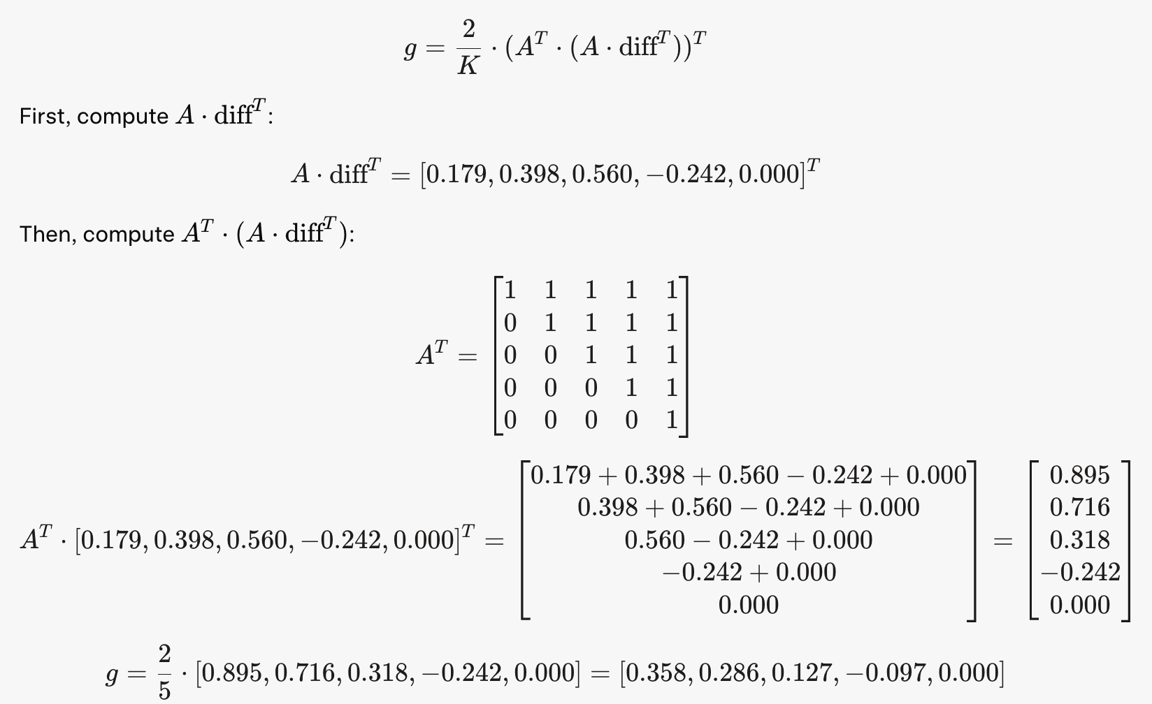
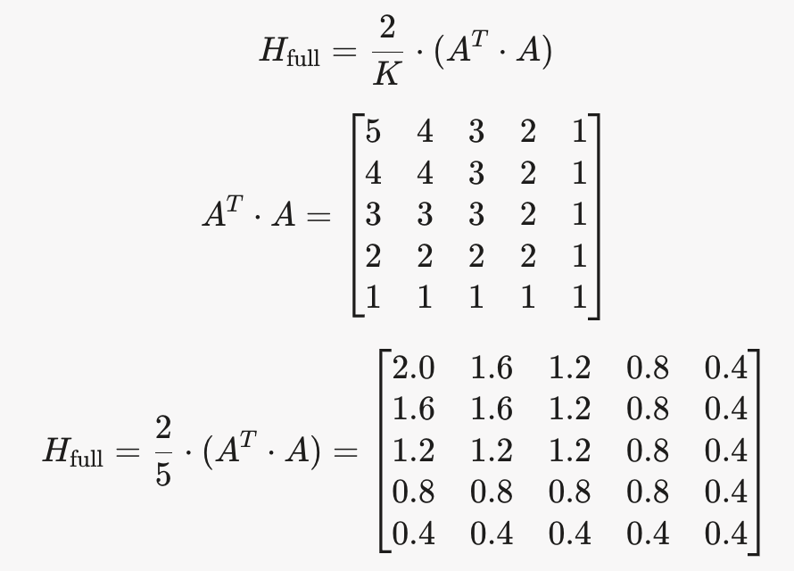


Step 5: Gradient
Compute the gradient:
Step 6: Hessian
Compute the Hessian matrix:
Take the diagonal:
$$\text{diag}\text{(}\text{H}\text{_}\text{full} \text{)=[2.0,1.6,1.2,0.8,0.4]}$$
Tile it for the sample:
$$\text{h}\text{=[2.0,1.6,1.2,0.8,0.4]}$$
Notes:
The diagonal Hessian (h=[2.0,1.6,1.2,0.8,0.4] is used during training to guide XGBoost’s tree-building process by indicating the curvature of the loss function, helping determine optimal splits and updates.

Slide 12
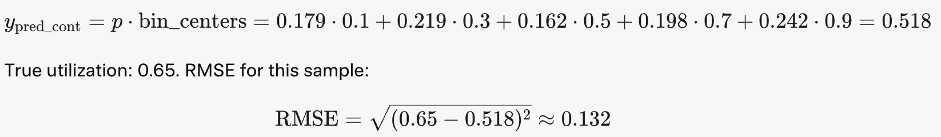
Step 7: Continuous Prediction
After training, the model outputs probabilities, e.g., p=[0.179,0.219,0.162,0.198,0.242]. The continuous prediction is:

